Slide 1
The way to success in CSCE 3600
Attend lectures and recitations
Ask questions (Be curious)
Implement code (use alternate resources e.g. vim / emacs / Eclipse /IntelliJ etc)
Work on programming assignments on your own (Minors)
Start working on assignments ahead of the deadlines

Slide 2
Why CSCE 3600
Use computers efficiently
Learn to interact with your computer’s Operating System
Show tools to develop efficient programs (terminals, shell, compilers, assemblers, linkers, loaders)
Combine tools to utilize your CPU efficiently

Slide 3
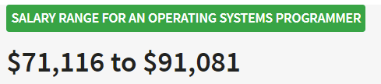
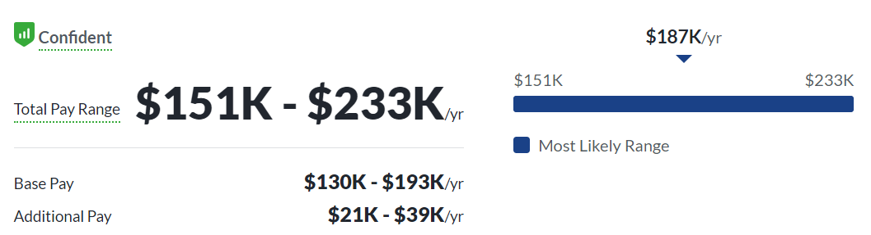
Job titles based on CSCE 3600
Systems Programmer
System Administrator
OS Programmer
Programming Analyst
Web Developer
App Developer
https://www.glassdoor.com/Salaries/operating-systems-programmer-salary-SRCH_KO0,28.htm

Slide 4
Assignments, Exams and Recitation schedule
Week # | Topic of discussion | Program Assignment | Recitation
1 | Systems Programming Overview
2 | Linux Overview / Gitlab | Major 1 Available | R1 Available
3 | Regular Expressions, sed/gawk |  | R2 Available
4 | sed/gawk, Bash | Minor 1 Available | R3 Available
5 | Bash, Review | Minor 1 Due / Minor 2 Available | R4 Available
6 | Processes | Minor 2 Due | R5 Available
7 | Processes | Exam 1
8 | Threads | Major 1 Due/Major 2 Available | R6 Available
9 | Threads, IPC 1 | Minor 3 Available | R7 Available
10 | IPC 1, Review | Minor 3 Due/Major 4 Available | R8 Available
11 | IPC 2 | Minor 4 Due | R9 Available
12 | IPC 2 | Exam 2
13 | Compilers & Compilation | Major 2 Due/Minor 5 Available | R10 Available
14 | Compilers, Python | Minor 5 Due
15 | Python, Review
16 | Final Exam | Final Exam

Slide 5
CSCE 3600 Principles of Systems Programming Systems Programming Overview
University of North Texas

Slide 6
Introduction
What is a system?
A system is a collection of various components
What is programming?
Programming is the activity of designing and implementing programs
So systems programming is the activity of designing and implementing system programs
We can then define system programs as programs required for the effective execution of general user programs on a computer system
Examples of systems programs??

Slide 7
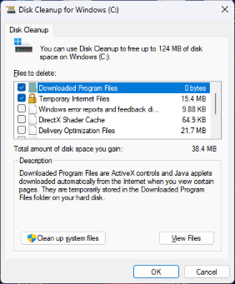
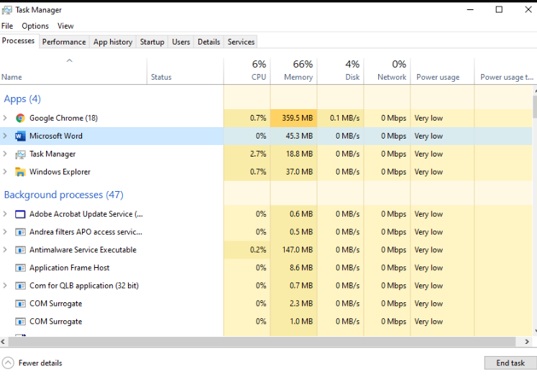
Introduction
Utilities for Systems programming
Disk Cleanup (Windows): Free disk space (removes unnecessary files)
Task Manager (Windows): Monitor & manage running processes and system performance.
Terminal (Unix/Linux): cmd.exe A command-line interface for interacting with the operating system. Putty

Slide 8
Introduction
Security Software:
Antivirus Programs (e.g., Norton, McAfee): Protects the system from malware and viruses.
Firewall Software (e.g., Windows Firewall): Monitors and controls incoming and outgoing network traffic.

Slide 9
Introduction
System Configuration Tools:
Control Panel (Windows): Provides access to system settings and configurations.
System Preferences (macOS): Allows users to configure system settings on Mac computers.

Slide 10
Software Categories
Two major categories
Application software
A program or set of programs used to solve a problem using the computer as an instrument (i.e., provides services to the user)
Word processors, web browser, media player, spreadsheets, etc.
System software
Supports the operation of the computer, which includes interfacing between the hardware and application software
Compilers, interpreters, assemblers, linkers, loaders, debuggers, operating system (OS), etc.
This course does not cover OS internals (covered in the CSCE 4600 Introduction to Operating Systems course).

Slide 11
Software Categories
System software | Application software
Used for operating computer hardware | Used by users to perform a specific task
Is installed on the computer when the OS is installed | Is installed according to a user’s requirements
Is concerned with the effective management of a computer system | Is primarily concerned with solutions of some problem using computer as a tool
User doesn’t interact with it because it works in the background | User regularly interacts
Can run independently and provides a platform for running application software | Cannot run independently – needs presence of system software to run
Uses low or middle level language to write system programs | Uses high level languages
E.g. compilers, assemblers, linkers, loaders, debuggers, device drivers etc. | E.g. media player, word processors, web browsers etc.

Slide 12
Programming Categories
System programs | Application programs
Writing programs for assemblers, compilers, editors etc. | Used for providing a means to facilitate applications such as payroll management system, MIS, MS word, Mozilla Firefox etc.
Closer to the system architecture | Not closely related to the system architecture
Not readable or user-friendly, difficult to make changes to programs | User-friendly, modifiable
Debugging is difficult | Debugging is not difficult
Error correction(fixing badly written programs) is not easy, but reliable | Error correction / Fault-fixing is easy and reliable
Makes machines to do work | Makes systems programs to do work
WHAT other differences CAN YOU THINK OF?.. | ….
… | ….

Slide 13
Complexity of OS
Operating systems are a class of exceptionally complex systems
Large, parallel, expensive, not well understood
Windows NT/XP: 10 years, 1000s of people – any bugs?
Complex systems are the most interesting
Internet, air traffic control, governments, weather, relationships, etc.
How to deal with this complexity?
Abstractions and layering
Goal: Systems that can be trusted with sensitive data and critical roles

Slide 14
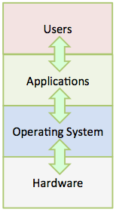
What is an Operating System?
The OS is a special program that resides between the computer hardware and application software
Controls and manages both hardware and software
For hardware, supports devices such as disk drives, keyboards, terminals, etc.
Manages application software, which uses the OS to communicate with these peripherals
Provides execution environment – the infrastructure for execution of programs, communication, and management of both physical and virtual resources

Slide 15
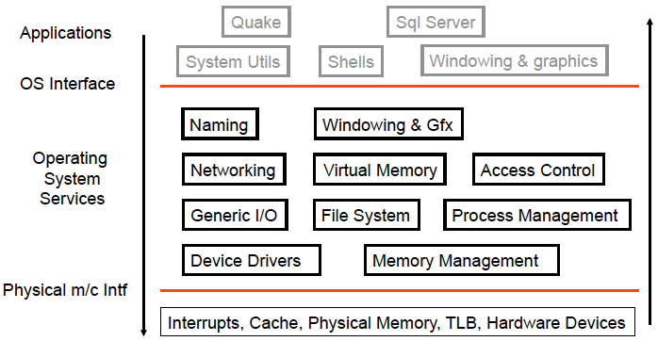
Logical OS Structure

Slide 16
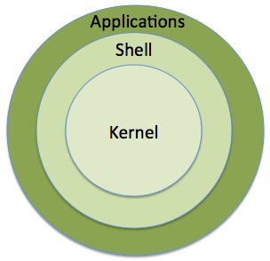

Composition of Linux OS
Kernel
Central part of OS
Provides direct interface to hardware and applications
Applications interact with kernel through system calls
Management of resources such as files, processes, devices, memory, network, etc.
Shell (Major 2 assignment)
Command interpreter provides interface between user and OS
Allows user to interact with Linux OS by reading, pre-processing, and executing commands
Applications

Slide 17
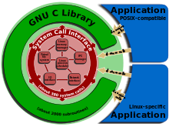
System Calls and the C Library
The application programming interface (API) allows user commands and applications indirect access to system resources and services through system calls
System libraries define a standard set of functions for applications to interact with the kernel
C library serves as the intermediary that facilitates these system calls
GNU C library (glibc) is standard C library in Linux
Provides basic application services, wrappers for system calls, and support for threading
To get glibc version on linux:
https://dev.to/0xbf/how-to-get-glibc-version-c-lang-26he

Slide 18
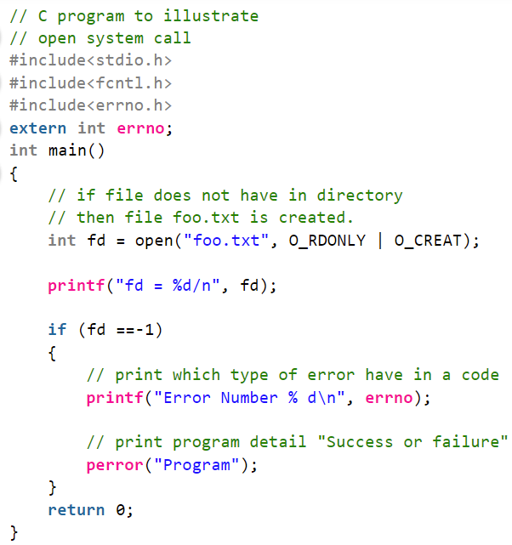
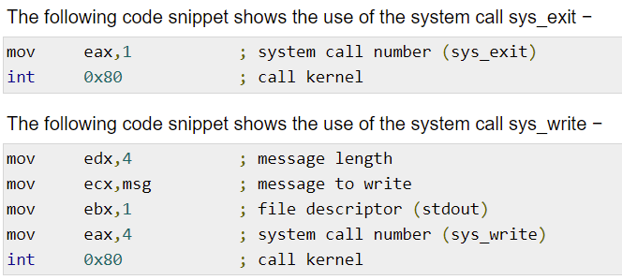
System Calls
System calls provide the interface between a running program and the operating system
Generally available as assembly-language instructions
Languages defined to replace assembly language for systems programming allow system calls to be made directly (e.g., C)
ASSEMBLY LANGUAGE
C LANGUAGE
Notes:
https://www.tutorialspoint.com/assembly_programming/assembly_system_calls.htm
https://www.geeksforgeeks.org/input-output-system-calls-c-create-open-close-read-write/

Slide 19
System Calls
Three general methods used to pass parameters between a running program and operating system
Pass parameters in registers
https://www.ibm.com/docs/en/aix/7.2?topic=calls-passing-parameters-system
Store the parameters in a table in memory, and the table address is passed as a parameter in a register
Push (store) the parameters onto the stack by the program, and pop off the stack by operating system
For more info: https://www.cs.mcgill.ca/~cs573/fall2002/notes/lec273/lecture15/15_4.htm
https://www.ibm.com/docs/en/aix/7.2?topic=calls-passing-parameters-system

Slide 20
System Call Operation
Dual Mode Operation
Kernel Mode: Supervisor or protected execution; executes with full access to all physical resources of computer
User Mode: Normal programs executed
Some instructions prohibited in user mode
Example: Cannot modify page tables in user mode
Attempt to modify results in exception generated
Function Call
Caller and callee are in the same process
Same user
Same “domain of trust”
System Call
OS is trusted; user is not!
OS has super-privileges; user does not
Must take measures to prevent abuse
Notes:
CPU usage is generally represented as a simple percentage of CPU time spent on non-idle tasks. But this is a bit of a simplification. In any modern operating system, the CPU is actually spending time in two very distinct modes:
Kernel Mode In Kernel mode, the executing code has complete and unrestricted access to the underlying hardware. It can execute any CPU instruction and reference any memory address. Kernel mode is generally reserved for the lowest-level, most trusted functions of the operating system. Crashes in kernel mode are catastrophic; they will halt the entire PC.
User Mode In User mode, the executing code has no ability to directly access hardware or reference memory. Code running in user mode must delegate to system APIs to access hardware or memory. Due to the protection afforded by this sort of isolation, crashes in user mode are always recoverable. Most of the code running on your computer will execute in user mode.

Slide 21
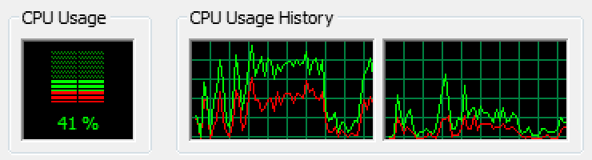
System Call Operation
CPU usage is represented as a percentage of CPU time spent on non-idle tasks. But this is a bit of a simplification. In any modern OS, the CPU is actually spending time in two very distinct modes:
Kernel Mode | User mode
code has complete and unrestricted access to the underlying hardware | code has no ability to directly access hardware or reference memory
can execute any CPU instruction and reference any memory address | Code running must delegate to system APIs to access hardware or memory
Crashes in kernel mode are catastrophic; they will halt the entire PC | crashes in user mode are always recoverable
https://blog.codinghorror.com/understanding-user-and-kernel-mode/

Slide 22
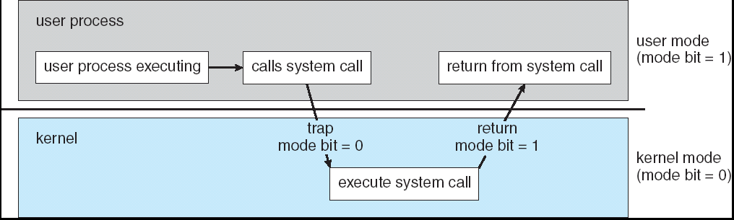
System Call Operation
System calls are expensive (due to context-switches) :
The computer (hardware) saves its state
OS code takes control of CPU, updates privileges
OS examines the call parameters
OS performs the requested function
OS saves its state (and call results)
OS returns control of the CPU to the caller
Transitions from user mode to kernel mode
Notes:
To get an idea of how many system-calls are required to run a basic program, just run "strace ls" on your Linux system. A system-call usually lead to a Context switch. It is the mechanism, a system implements multi-tasking. State of process from each register saved to the memory and context of some other process is loaded from memory into the CPU.
Now, why system calls are expensive? Firstly, almost every system call leads to a context switch. So, context of the running process has to be loaded into memory and then context of system-call has to be loaded into CPU, that is first context switch. And then context of the process has to be loaded back into the CPU, thereby causing one more context switch. In most of the systems, a system call doesn't need a complete process context switch, it only needs privilege mode context switch. But it will still lead to increase in memory lookup times. As caching structure is generally 2-4 levels, and system call might have made cache irrelevant. So when resumed program, looks for data it will not find it in lower-level caches, and it has to be fetched from memory thereby increasing the lookup times from all the lower-level caches.
Secondly, if system call is related to network or disk read-write, it will have io wait time. Which again wastes processor time, without doing any useful task. Running "vmstat" on your system will show io-wait times in "wa" column.

Slide 23
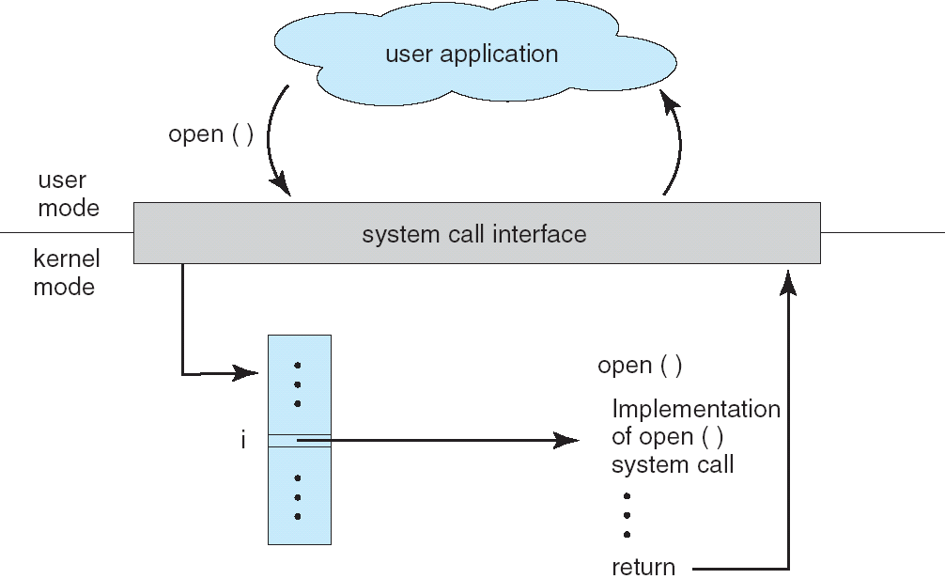
System Call Example

Slide 24
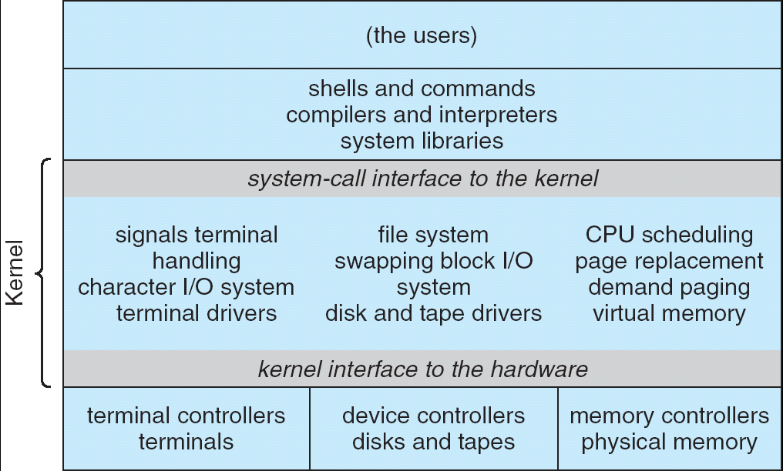
System Call Structure
Applications
User Mode
Standard Libs
Kernel Mode
Hardware

Slide 25
System Calls Categories
System calls can be grouped into 5 categories:
Process Control
End, abort, load, execute, create process, terminate process, allocate and free memory
File Manipulation
Create file, delete file, open file, close file, read file, and write file
Device Manipulation
Request device, release device, read, write
Information Maintenance
Get time or date, set time or date, get process or file or device
Communications
Create or delete communication connection, send and receive messages

Slide 26
System Calls vs. Library Calls
Each I/O system call has corresponding procedure calls from the standard I/O library
System calls | Library calls
open | fopen
close | fclose
read | fread, getchar, scanf, fscanf, getc, fgetc, gets, fgets
write | fwrite, putchar, printf, fprintf putc, fputc, puts, fputs
lseek | fseek

Slide 27
System Call Usage
System calls are primarily used to
Manage the file system
Control processes
Provide communication
When system call causes an error
returns –1
Stores error number in variable called errno given in header file called /usr/include/errno.h
Then calls to perror() displays argument string, colon, and actual error message
Example
if (unlink("text.txt") == –1)
{
perror("delete");
}
Notes:
A file system is a complete directory structure, including a root directory and any subdirectories and files beneath it.

Slide 28
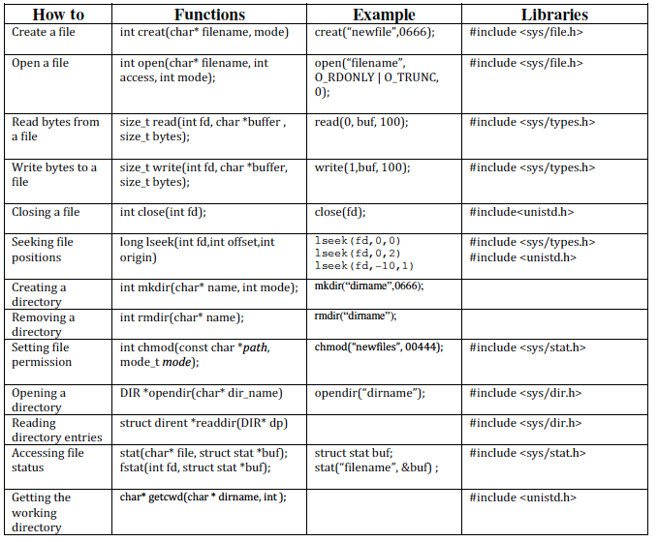
System Call Examples

Slide 29

What is Linux?
This course studies systems programming using Linux
Linux is a multiuser, multitasking operating system
Allows users to run applications, manage resources, and communicate with other systems
Has a very Unix-like feel, but is a free and open source OS
Many Linux distributions
Consist of Linux kernel, basic software and utilities, and software package manager
Debian (including Ubuntu derivative), Fedora, Gentoo, and Kali
How to Connect to UNT’s CELL Machines? https://computerscience.engineering.unt.edu/centralized-environment-linux-labs-cell-machines
https://www.kernel.org/linux.html

Slide 30
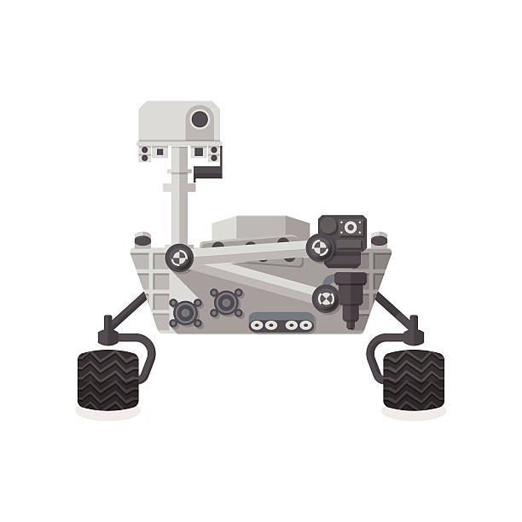
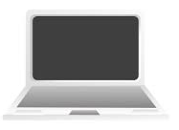
Why Study Systems Programming?
Learn how to build complex systems
How can you manage complexity in future projects?
Engineering issues
Why is the web so slow sometimes? Can you fix it?
What features should be in the next Mars Rover?
How do large distributed systems work?
Buying and using a personal computer
Why different PCs with same CPU behave differently?
How to choose a processor?
Should you get a Windows/Linux/Macintosh?
Business issues
Should your division buy thin-clients vs. desktop PC?
Security, viruses, and worms
What exposure do you have to worry about?
Notes:
Thin clients are lightweight computers with all of their resources available on a central server instead of a hard disk. Every thin client is connected to a remote server and all applications, data, and memory are stored on the server. This centralized approach in a VDI Thin Client & Cloud computing environment makes the technology secure and cost-efficient.
One can increase or decrease the computational power of these noise-free machines within a few seconds as there is no need to add or remove a localized component. Another valued benefit of using a Thin client is low power consumption because it relies on a server to perform most of its computing functions. These functionalities have made these machines popular in the finance, defense, banking, healthcare, and other sectors where one needs several computers working together to manage workloads.

Slide 31
Functionality Complexity
Every piece of computer hardware is different
Different CPU (Pentium, PowerPC, ARM, MIPS, …)
Different amounts of memory, hard drive, …
Different types of devices (mice, keyboards, cameras, …)
Different networking equipment (NICs, wireless, cable, …)
Questions
Should the programmer write a single program that performs many independent activities?
Does every program have to be altered for every piece of hardware?
Does a faulty program crash everything?
Does every program have access to all of the hardware?

Slide 32

Review of C

Slide 33
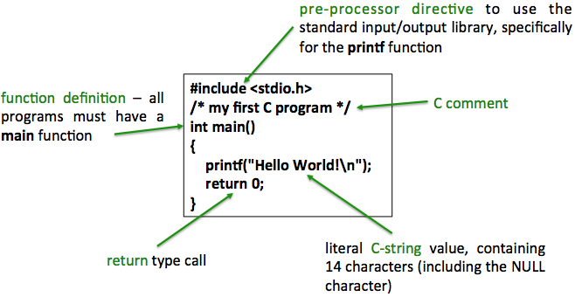
Programming in C

Slide 34
Similarities Between C and C++
Built-in data types
Same compiler preprocessor
Handles #include and #define
Conditional preprocessing #if, #ifndef, #endif, etc.
Other directives
Data Types
Primary Data Types
Secondary Data Types
Character
Integer
Float
Double
Void
Array
Pointer
Structure
Union
Enum, etc.
Details in another lecture

Slide 35
Similarities Between C and C++
Same built-in operators on primitive types
Category | Operators
Primary | x.y f(x) x++ x-- new typedef
Unary | + - ! ~ ++x --x
Multiplicative | * / %
Additive | + -
Shift | << >>
Relational and type testing | < > <= >=
Equality | == !=
Logical | AND &
Logical | XOR ^
Logical | OR |
Conditional | AND &&
Conditional | OR II
Conditional | ?:
Assignment | = *= /= += -= <<= >>= &=

Slide 36
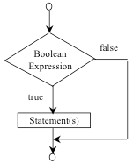
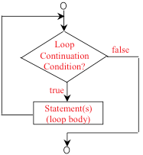
Similarities Between C and C++
Same built-in control structures
E.g., if, for, while, switch, etc.
Must have a function named main to determine where the program starts
Functions are defined the same way
E.g., function prototypes, definitions, and calls
Programs can be split up into separate files

Slide 37
Differences Between C and C++
C follows a procedural programming paradigm
C++ is multi-paradigm language (both procedural and object oriented)
In C, importance is given to steps of the program
C++ focuses on the data rather than the process – this typically makes it easier to implement/edit the code in C++
In C, the data is not secured while the data is secured (really, hidden) in C++
This is due to specific OOP features like data hiding not present in C
C is a low level language while C++ is a middle-level language
Interpretation is more difficult and less user friendly in C while C++ has features of both low-level (i.e., focus on machine hardware) and high-level (concentration on program itself)

Slide 38
Differences Between C and C++
C uses the top-down approach while C++ uses the bottom-up approach
In C, the program is formulated step-by-step
In C++, the base elements are first formulated and then linked together to give rise to larger systems
C is function-driven while C++ is object-driven
Functions are the building blocks of a C program while objects are the building blocks of a C++ program
C++ supports function overloading while C does not
Function overloading is done with the help of polymorphism, an OOP feature

Slide 39
Differences Between C and C++
The NAMESPACE feature in C++ is absent in C
C++ uses NAMESPACE to avoid name collisions
The standard input and output functions differ in the two languages
C uses scanf() and printf() while C++ uses cin >> and cout << as their respective input and output functions
C++ allows the use of references variables while C does not
Reference variables allow two variable names to point to the same memory location
C++ is a superset of C and can run most of C code while C cannot run C++ code, but C has its own existence especially in systems programming

Slide 40
Bitwise Operators and Memory

Slide 41
Bitwise Structure
The smallest type is 8 bits (i.e., char)
A single bit cannot be accessed directly since it has no address of its own
Bitwise operators introduced by C language provide one of its more powerful tools for using and manipulating memory
Give C the real power of a “low-level language”
Accessing bits directly is fast and efficient, especially if you are writing a real-time application
Bitwise operators perform a bit-by-bit operation on integral types only (unsigned types are preferable)

Slide 42
Bitwise Operators
All of these operators can be suffixed with =
For example, x &= y; is equivalent to x = x & y;
Operator symbol | Operation performed
& | bitwise AND
| | bitwise OR
^ | bitwise XOR
~ | 1’s compliment
<< | Shift left
>> | Shift right

Slide 43
Bitwise Operators
Assume
x = 60 0011 1100
y = 13 0000 1101
Examples
x & y 0000 1100 AND
x | y 0011 1101 OR
x ^ y 0011 0001 XOR
~x 1100 0011 1’s Complement
x << 2 1111 0000 Shift Left 2 Bits
x >> 1 0001 1110 Shift Right 1 Bit

Slide 44

Setting and Getting Bits
Suppose we want to store the status of lights (on or off) in 8 rooms
We can define an unsigned char with 8 bits, each bit storing the value 0 or 1
How can we set a bit on or off?
Manipulations enabled by a mask and bitwise operators
How can we know if a bit is on or off?
Manipulations are enabled by mask and bitwise operators
Bitwise OR of anything with 1 results in 1 – Bitwise AND of anything with 0 results in 0
Bitwise AND of anything with 1 results in the same value

Slide 45
Memory Manipulation Functions
void *memcpy (void *dest, const void *src, size_t n);
Copies block of n bytes src -> dest; returns ptr to dest
void *memmove(void *dest, const void *src, size_t n);
Moves block of n bytes src -> dest; returns ptr to dest
void *memset (void *s, int c, size_t n);
Sets n bytes of s to byte c
void *memchr (const void *s, int c, size_t n);
Searches first n bytes of array s for char c; returns ptr to s
int memcmp (const void *s1, const void *s2, size_t n);
Compares first n bytes of arrays s1 & s2; case sensitive

